Slide 1
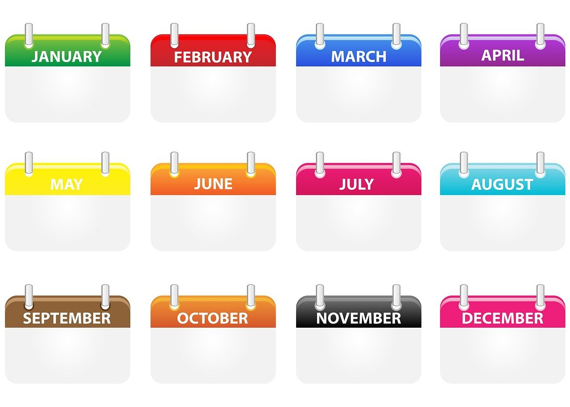
What a year!

Slide 2
Warm-up task:
Create a collaborative glossary of key terms about knowledge and politics.

Slide 3
Which 3 TOK concepts do you find most relevant to this theme? (knowledge and politics)
Justify your answers (orally)
TOK concepts: evidence, certainty, truth, interpretation, power, justification, explanation, objectivity, perspective, culture, values, and responsibility

Slide 4
Collaborative brainstorming What happened in the year so far?
Use research tools if necessary.
Use large witing spaces
Compile the list collaboratively.
Keep your findings handy, because we will use them for follow-up tasks.

Slide 5
Might some facts/events from the year so far inconvenient to certain politicians? Which ones might be convenient to some politicians? Which facts could be altered, presented differently, or manipulated in order to present them in a better light? How could this be done?
Follow-up discussion
Look at the list of events and facts you have compiled regarding the year so far. Then, consider the following questions:

Slide 6
Core activity: What a year! Create and present a speech about the year so far for your political persona in question.

Slide 7
What a year! How to complete the core task.
Choose one political persona or someone who embodies a particular perspective.
2) Consider how each “fact” or “event” your brainstormed earlier would (or would not) suit your political persona’s agenda.
3) How could you manipulate these “facts” and “events” to suit the persona’s political
agenda? Research statistics, expert opinion, reports, studies etc to support your (possibly false) claims.
4) Create a speech for their political persona. Mention key events of the year, but also use things such as fallacious reasoning, manipulation of statistics, selection bias, and other techniques to present your persona favourably. Use euphemisms and pejorative language.

Slide 8
Presentation of the speech.
One person presents the speech “in character”.
The other team members act as advisors and answer to the press.
The audience acts as the press and asks interesting questions.

Slide 9
Plenary reflection:
What did you learn from the activity?
How will you aim to unpick logical fallacies and flawed political arguments in the future?
Which TOK concepts and (new) terminology did you consider during these lessons?

