Slide 1
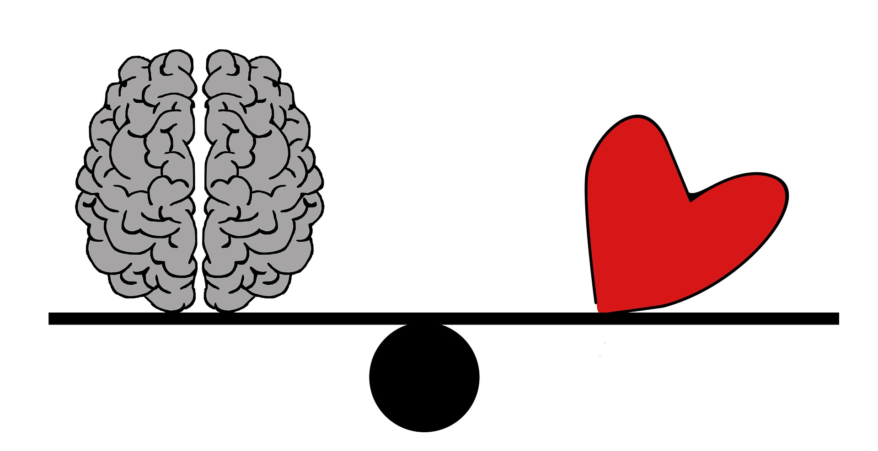
Rational politics?

Slide 2
Warm-up (think-pair-share):
Are you ever biased?

Slide 3
What shapes my political views?
Is it possible that you may be unaware of some facors?
Brainstorm any possible factors you can think about (see handout)

Slide 4
To what extent are our political views shaped by society, family backgrounds, education or social class?

Slide 5
Research and exhibition practice
Choose ONE of the following knowledge questions:
What role does emotion play in the formation of political affinities or voting decisions?
OR
How might emotive language and faulty reasoning be used in politics to try to persuade
and manipulate?
2) Search for ONE real world example that illustrates your chosen knowledge question.
3) Present your findings in a visual form (object or image).
Possible examples: a propaganda poster, a tweet by a president, a transcript of a speech, a gravestone of a political hero, the cover of a magazine

Slide 6
Do politics make us irrational?
Video from TED.ed.com

Slide 7
Logical fallacies Some major fallacies and a little bit of practice. (see handout)

Slide 8
Informal reasoning
Human beings are prone to improper reasoning. Apart from invalid syllogisms and hasty generalisations, you will probably find many examples in your daily life of the following fallacies.
Post hoc ergo propter hoc
Argument ad hominem
Special pleading
Circular reasoning
Argument ad ignorantiam
False analogy
Loaded questions
Equivocation
False dilemma

Slide 9
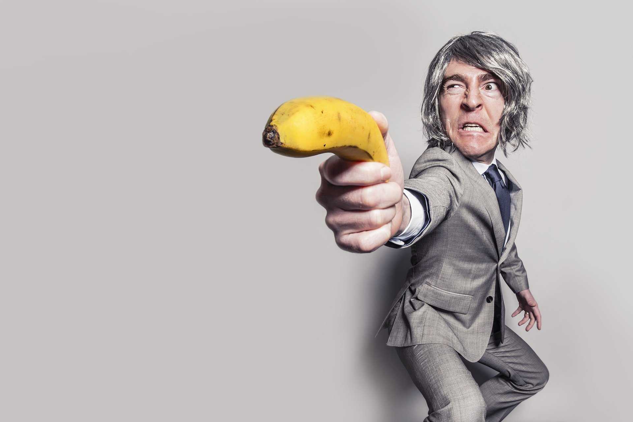
Since strict gun control laws were introduced in Texas, the crime rate has risen. This shows that gun control does nothing to reduce crime.
Post hoc ergo propter hoc.
It happened after, so it must be caused by.

Slide 10
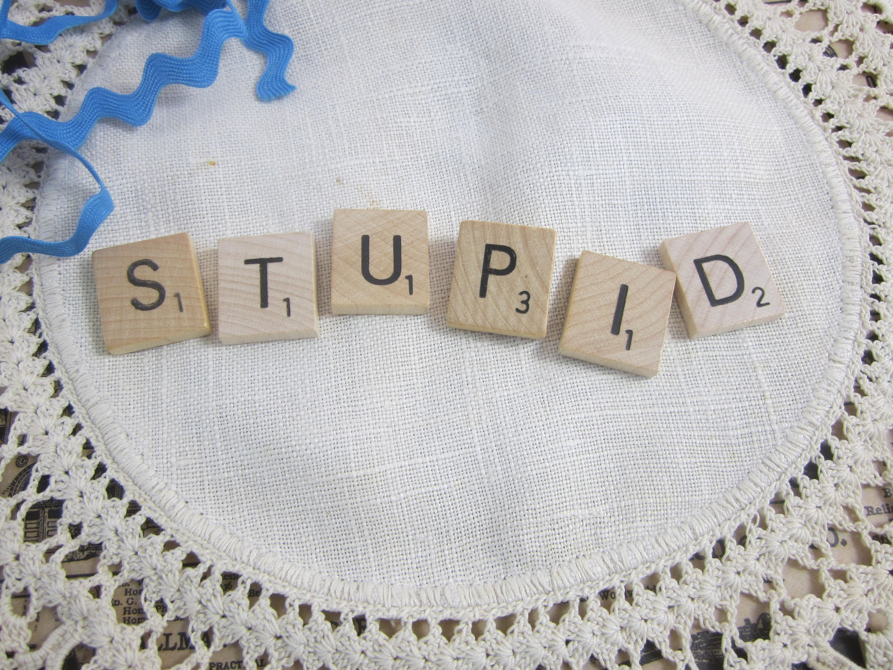
Argument ad hominem.
You are so stupid, your argument couldn’t possibly be true.
Attacking the arguer, not the argument.

Slide 11
I agree that everyone should pay their taxes. But since I’m short of money this year and want to take my family on a much needed holiday, it’s OK if I don’t declare my income.
Special pleading
Using double standards to excuse an individual or a group.

Slide 12
Circular reasoning
Assuming the truth of what you are supposed to be proving

Slide 13
Since no one has been able to prove that there are no ghosts, we must conclude that ghosts exist.
Argument ad ignorantiam
Claiming something is true because it cannot be proved to be false.

Slide 14
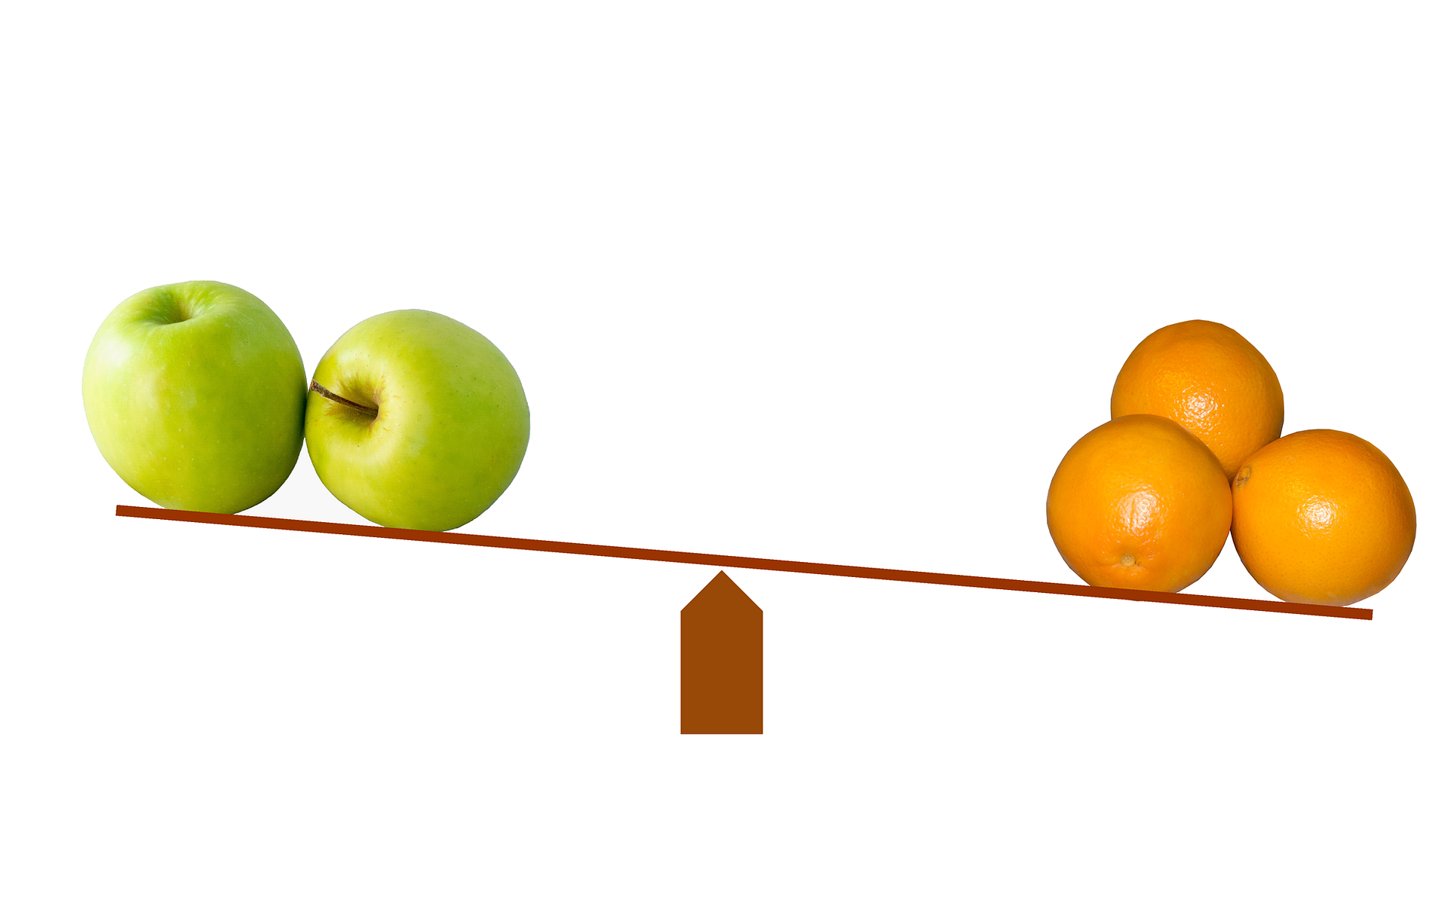
False analogy
Assuming that because two things are alike in some respects they are alike in other respects.

Slide 15
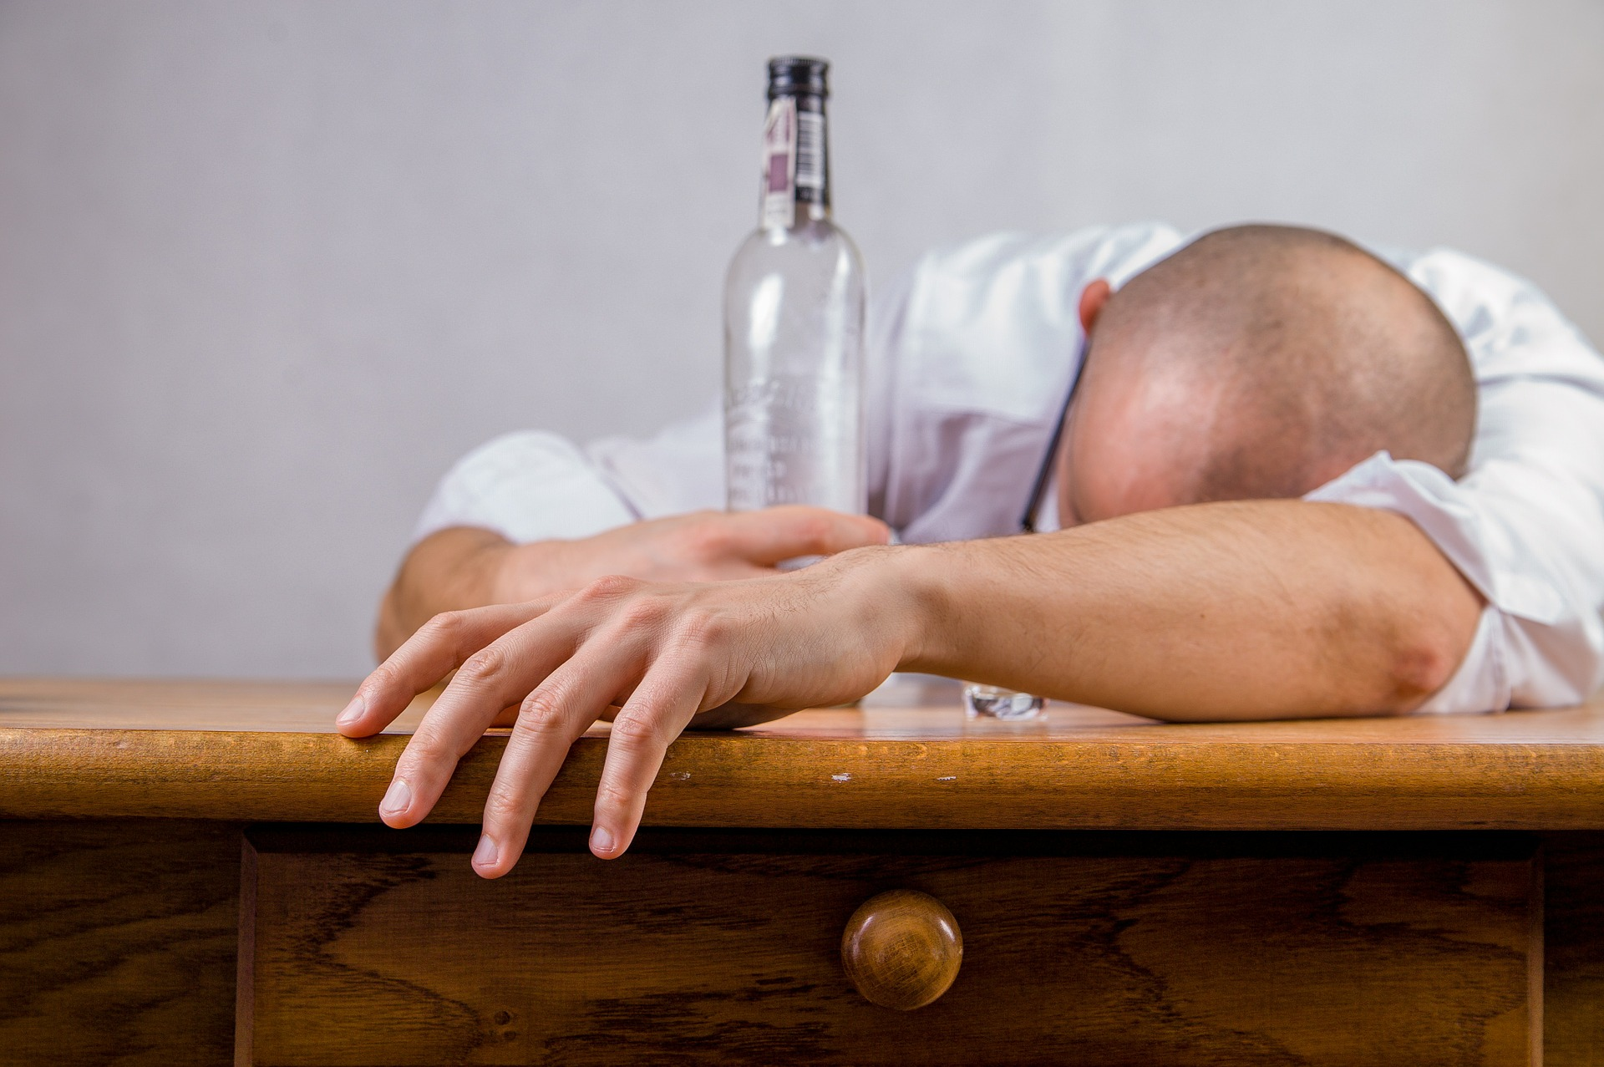
Begging the question
The headmaster did not come to school drunk today.
Assuming an answer in the way the question is phrased.
Loaded questions/
statements
A question/
statement which has a built-in assumption.

Slide 16
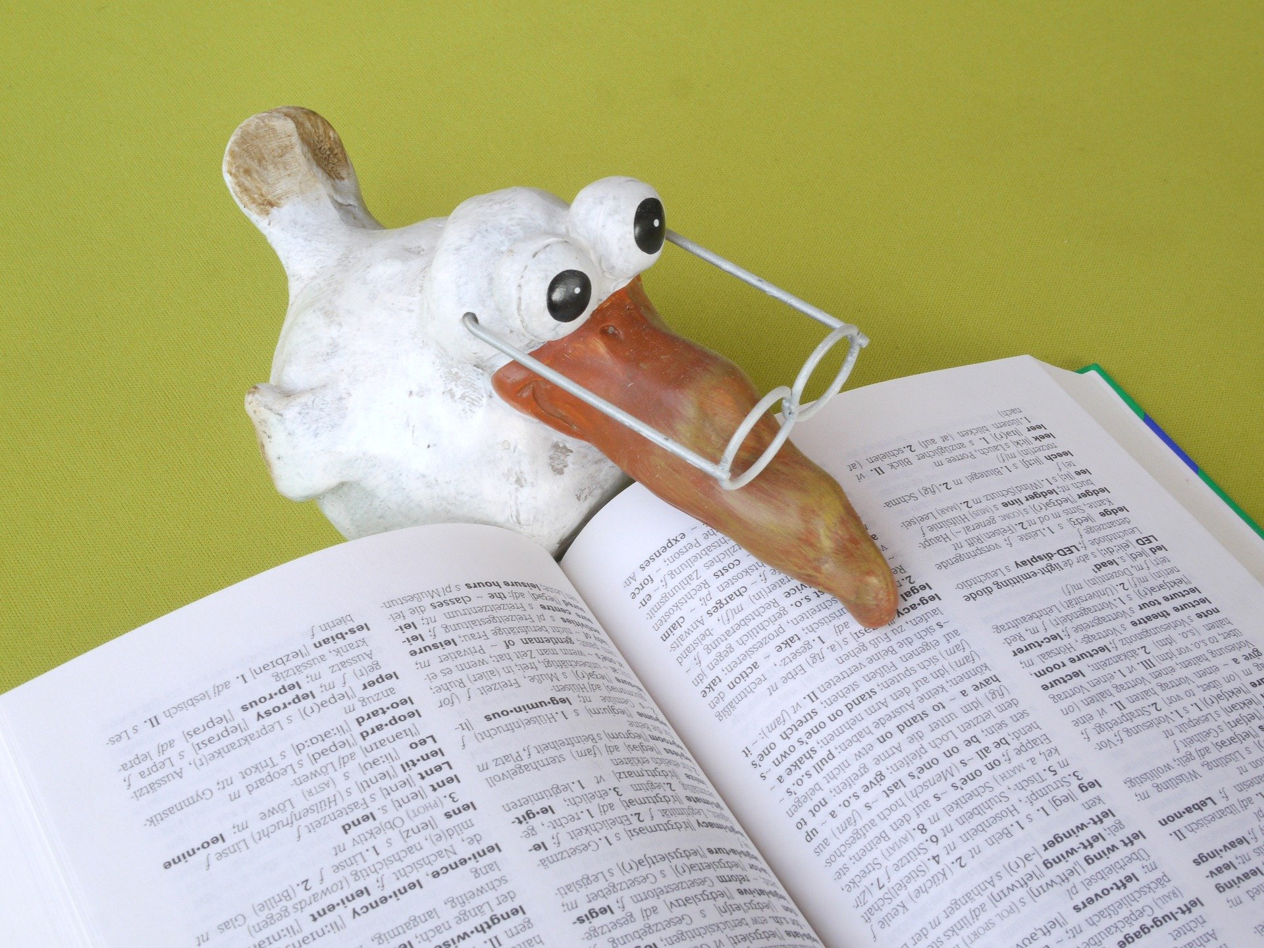
Equivocation
Using language ambiguously. A word is used in two different senses within one argument

Slide 17
Excluding the middle
False dilemma or false dichotomy
Considering only the two extremes in a range of possibilities (making the other side look worse than it actually is)
Exaggerated either/or. Assuming that only two black and white alternatives exist.

Slide 18
Penguins are black and white. Some old TV shows are black and white. Therefore, some penguins are old TV shows.
Non sequitur
Assumes a logical link between separate points.

Slide 19
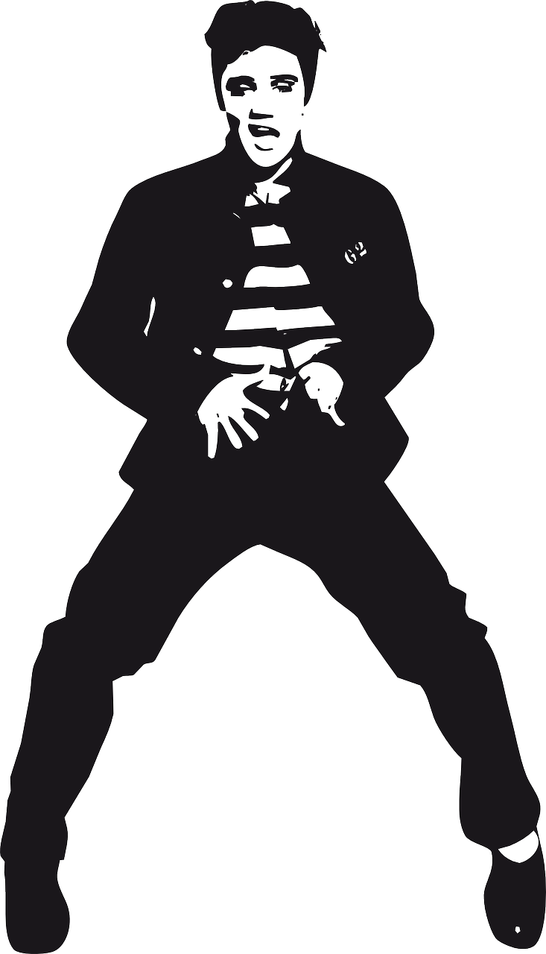
50 000 000 Elvis fans can’t be wrong!
Argument ad populum
Everyone says it’s true.

Slide 20
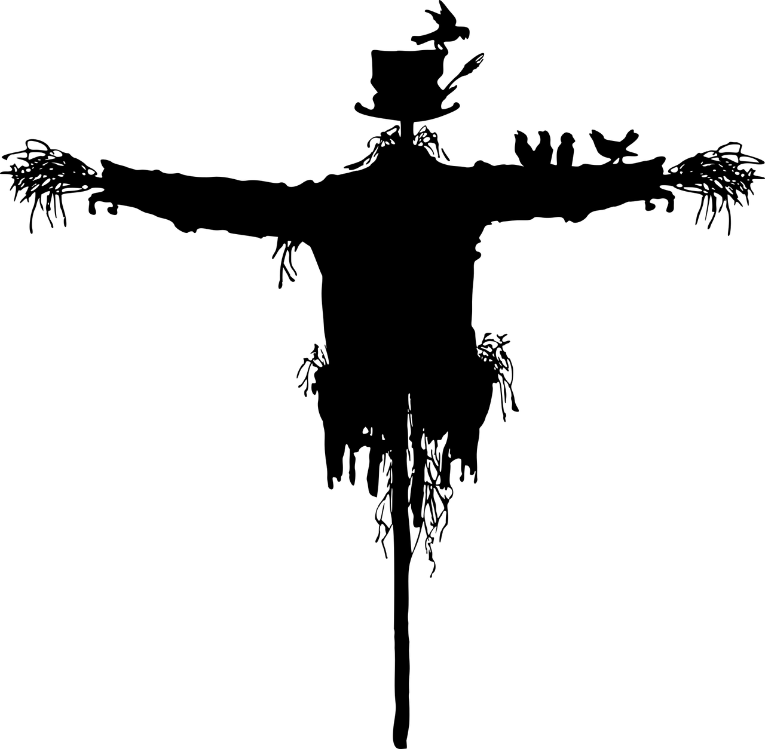
Straw man
Caricaturing a position to make it easier to attack.

Slide 21
25 Logical fallacies made by politicians.
Video from www.youtube.com

Slide 22
Plenary Reflections
How might I be able to reach better conclusions when faced with political knowledge in the future?
What bias should I be aware of?
How could I uncover flawed arguments?
How should I select my news better?

