Slide 1
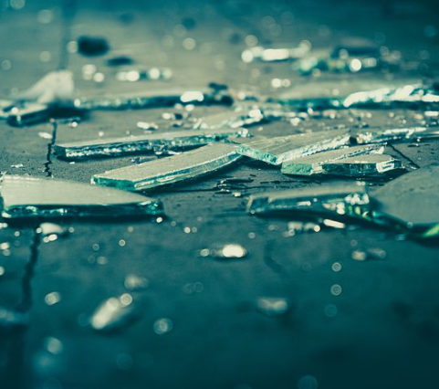
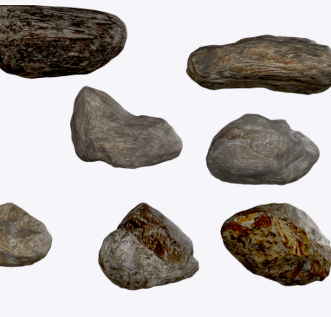
Images taken from Pixabay
Notes:
Before you get started: if possible, bring some “props” to class, which may help students get into their roles. Possible ideas are a robe for the judge, a hammer, a piece of evidence (something that looks like a broken piece of glass, or a stone etc. Alternatively, you can print the photos of this slide as evidence.

Slide 2
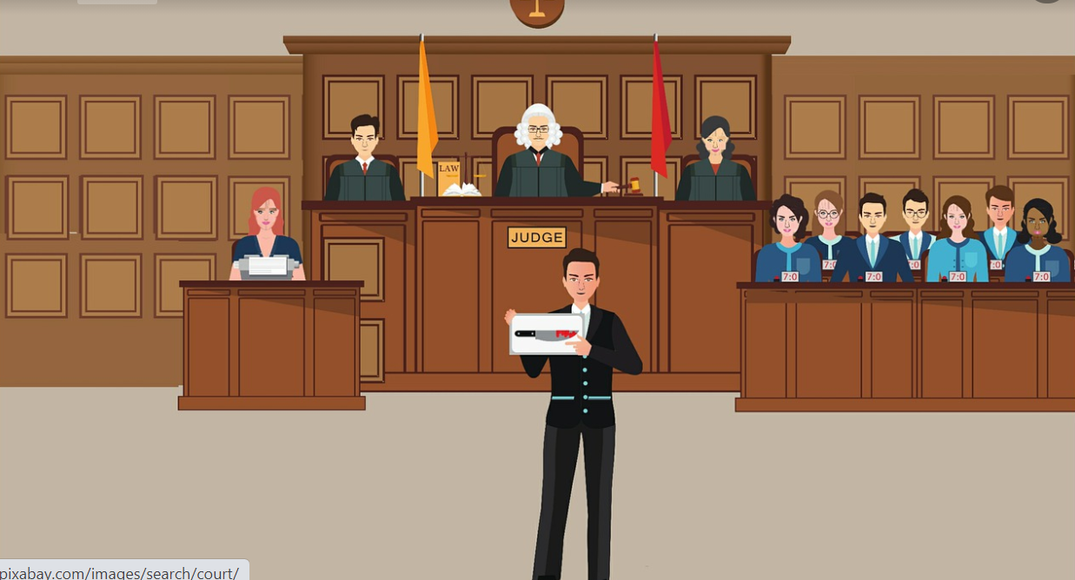
Judgement day
Notes:
Explain to your students that today they will hold a mock mini trial. Stress that formalities are not important for the purpose of this exercise. The aim of the lesson (although you may not want to tell them that yet) is to focus on how we know things, how we reach conclusions based on evidence, how the knower him/herself may affect the conclusions s/he reaches, despite being presented with the same facts and evidence etc.

Slide 3
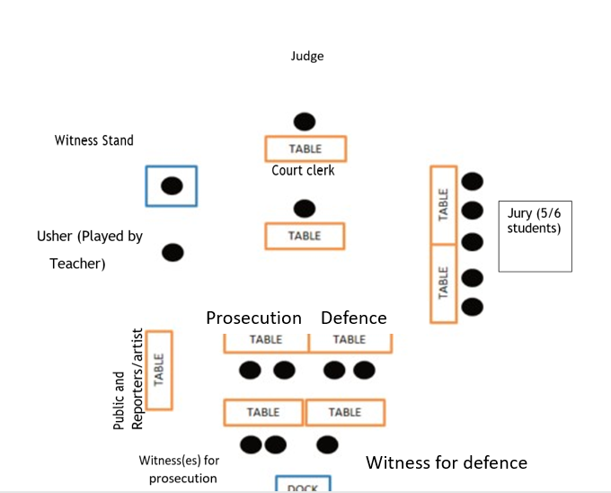
Classroom organisation
Notes:
Before starting the mini mock trial, it is a good idea to arrange the classroom so it represents a courtroom. It could look a bit like the image above.

Slide 4
Warm-up (think-pair-share):
What happens during a trial?
Notes:
Recap by asking students what they remember of the previous lesson.

Slide 5
The mini trial: running order
The judge addresses the courtroom and explains why we are here today. Then s/he asks the jury if anyone knows a person involved in the case, feels they cannot be fair, stands to benefit from a decision in the case, or has already formed an opinion about the case.
The lawyer for prosecution makes a short statement explaining why Bart is guilty.
The lawyer for defence makes a short statement explaining why Bart is not guilty.
The witnesses for prosecution come to the front and answer questions from both lawyers.
The witnesses for defence come to the front and answer questions from both lawyers.
Any evidence can be presented to the court. Questions based on evidence can be asked.
The judge tells the jury to discuss the evidence and reliability of the witnesses and deliberate.
The jury reaches a conclusion.
Throughout the entire process, the sketch artist draws what s/he sees.
The reporters do a write-up of the case.
Notes:
Explain the running order to the students. Refer to this running order throughout the trial. The running order is also available on the lesson plan and in the footnotes of the next slide. Note that this is a simplified, mini mock trial. Students are allowed to improvise a bit and are not required to use formal legal language for the purpose of this exercise. This is different from the more formal mock trials. This is because the true focus of the lesson lies ultimately with TOK.

Slide 6
The case: The State versus Bart
The issue: Did Bart throw the stone that broke Principal Skinner’s window?
Facts
Bart and several of his friends were riding their bikes around the neighborhood on Friday, March 15. At about 6:00 p.m. a few kids from a different neighborhood rode by Bart and his friends. They teased Bart and his friends and dared them to throw stones at Principal Skinner’s windows. Principal skinner is a man of a certain age who often tells the children to stay off his property. Several windows were broken, and when Principal Skinner ran out of his house to stop the children, he recognized Bart. The State has now charged Bart with the crime of vandalism.
Notes:
Remind the class about the case. Leave this slide up throughout the case. Then proceed with the running order, as explained through the previous slide and also mentioned in the lesson plan. The running order is also mentioned here:
The judge addresses the courtroom and explains why we are here today.
The lawyer for prosecution makes a short statement explaining why Bart is guilty.
The lawyer for defence makes a short statement explaining why Bart is not guilty.
The witnesses for prosecution come to the front and answer questions from both lawyers.
The witnesses for defence come to the front and answer questions from both lawyers.
Any evidence can be presented to the court. Questions based on evidence can be asked.
The judge tells the jury to discuss the evidence and reliability of the witnesses and deliberate.
The jury reaches a conclusion.
Throughout the entire process, the sketch artist draws what s/he sees and the reporters do a write-up.

Slide 7
Notes on the following slides: The next slides will be hidden. Do not show them to the class as a whole. Last lesson, you will have printed/shared the following slides with the respective students. Each slide represents one or more pieces of the puzzle, that makes up the court trial. In case you (or the students) need a reminder about the content of the slides, they have been embedded in this powerpoint as well (slides 7-11). If you don’t need a reminder/have the printouts handy, skip back to slide 6.

Slide 8
Prosecutor witness statements
Principal Skinner:
I have lived in this neighborhood for 47 years. My mother and I built our little house when I started teaching. My mother died five years ago. Since then, I have been a victim of many attacks of vandalism. On Friday evening, March 15, I was watching the 6:00 p.m. news when I heard glass breaking in my front porch. I ran out my back door and around the house to see what was going on. I saw lots of kids. I recognized Bart because he lives down the block and often rides his
bike past my house. It was clear to me that this group of kids was responsible for breaking my windows. In fact, Bart had a rock in his hand and was getting ready to throw it.
Notes:
Print this slide 5 times and hand it to the student playing Principal skinner, as well as the lawyers.

Slide 9
Prosecutor witness statements
Leila, the paper carrier:
I have delivered newspapers to Principal Skinnner’s neighborhood for three years. On Friday, March 15,
I was delivering a newspaper to Ms. Crowley, who lives three houses away from Principal Skinner, when I heard kids screaming and then I heard breaking glass. I ran over to Principal Skinner’s house. I saw about 10 children on the front yard. Bart and another kid were pushing each other. It looked
to me like the other kid was trying to stop Bart from throwing a stone. I did not see anyone throw stones.
Notes:
Print this slide 5 times and hand it to the student playing “Leila” as well as the lawyers.

Slide 10
Defence witness statements
Milhouse,
Bart and I were out riding our bikes with some other friends on Friday, March 15. We were riding up and down Barts block when a bunch of kids we didn’t know rode up to us and started teasing us. They dared us to throw stones at grouchy old Principal Skinner’s windows. We tried to ignore them. They threw a stone and hit a front porch window. Then they threw some more stones. I think a couple of windows were broken. Bart and I and our friends stood and watched. When one of the other kids picked up a stone to throw, Bart tried to stop him. Then Principal Skinner came around the house. The other kids said they didn’t throw the stones, they said that Bart did. I think they were mad at Bart because he tried to stop them. Bart is a real nice friend, he wouldn’t try to break Principal Skinner’s windows.
Notes:
Print this slide 5 times and hand it to the student playing Milhouse, as well as the lawyers.

Slide 11
Defence witness statements
Bart, defendant
I was riding bikes with my friends on Friday, March 15. It was almost getting dark when a bunch of kids we didn’t know rode up to us and started bugging us. They wanted us to throw rocks with them. They were going to try to break some of Principal Skinner’s front porch windows. Even though I don’t like Principal Skinner very much, we said we wouldn’t do that. I saw one kid standing next to me pick up a rock. I tried to take it out of his hand so he wouldn’t throw it. That’s when Principal Skinner came around the corner. Leslie the newspaper carrier also showed up. I did not throw any stones.
Notes:
Print this slide 5 times and hand it to the student playing Bart, as well as the lawyers.

Slide 12
Post-trial discussion What went well? What was challenging? Was it easy reaching a decision based on witness statements? Was there sufficient evidence available? Was there something that made you doubt the evidence? The statements? The decision your reached?
Notes:
Go through the discussion questions above as a whole class activity. Then explain to students that we will now bring the discussion back to TOK, and the theme of knowledge and the knower in particular and that we will draw a comparison between reaching a decision in a court case and our quest for knowledge as a whole.

Slide 13
Going back to TOK: “Our role as a knower”. Plenary reflection of knowledge questions.
Notes:
Explain that you are now going back to TOK, and a discussion of our role as a knower in particular. Tell the students that the next slide will contain a couple of knowledge questions to guide the reflection.

Slide 14
Plenary reflection: Knowledge questions
Do all claims require evidential support?
What constitutes a “good reason” for us to accept a claim?
How much of our knowledge depends on our interactions with other knowers?
Are intuition, evidence, reasoning, consensus and authority all equally convincing justifications for a claim?
Notes:
Students choose one of the knowledge questions. Based on the lats two lessons, they compose a 150-200 word response in their TOK journals.

