Slide 1
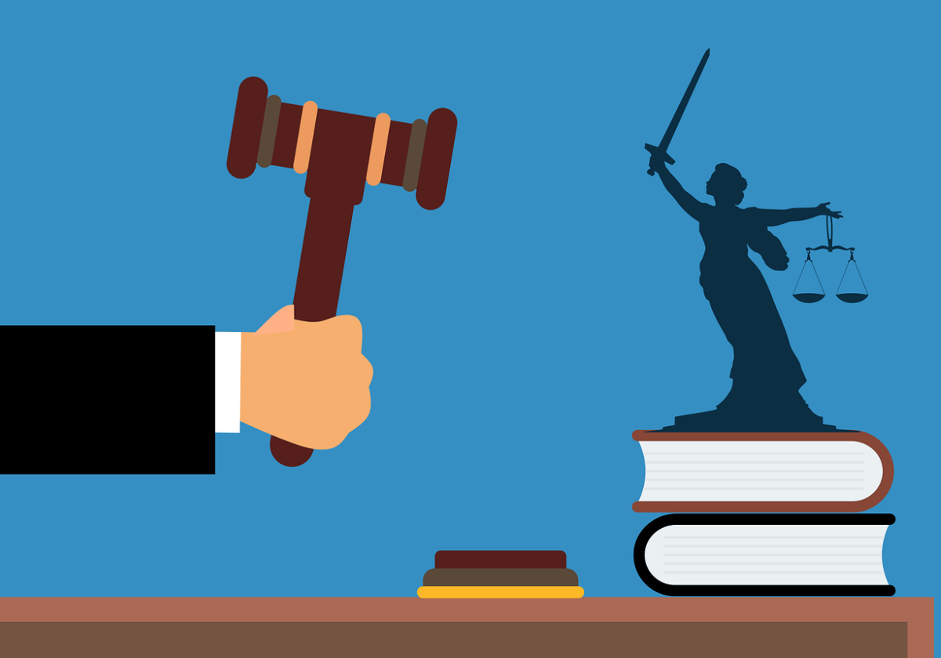
Preparing for a mini mock trial
Image by Muhammad Hassan from Pixabay
Notes:
Explain to your students that today they are going to take part in a mini mock trial. Today’s lesson is all about understanding the proceedings of a trial and preparing for the trial. Stress that formalities are less important in this case. The lessons focus on evidence, decision making etc, rather than the smooth and accurate proceedings, associated with a traditional mock trial.
To avoid confusion, all printable resources/handouts are embedded within this powerpoint. These slides will be hidden when presenting. Before teaching the lesson, print the following slides: 6, 7, 14 (one copy per jury member), 15 (3 times), 16 (3 times), 17 (3 times), 18 (3 times).

Slide 2
Warm-up (think-pair-share):
What happens
during a trial?
Who are the main players?

Slide 3
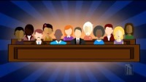
Explanatory video 1
Video from youtube.com:https://www.youtube.com/watch?v=grnUvCNAfGA&t=15s

Slide 4
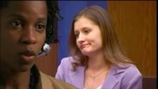
Explanatory video 2
Video from youtube.com: www.youtube.com/watch?v=lME3xXa8y-c

Slide 5
Find your matching card: You will get a card with either a definition, or a term related to roles in a trial. Walk around the classroom and find your matching definition.
Notes:
Teachers: print the next two slides and cut these up. Hand them out randomly to the students. Duplicate the printouts of necessary, to allocate some roles/definitions twice, depending on your class size.

Slide 6
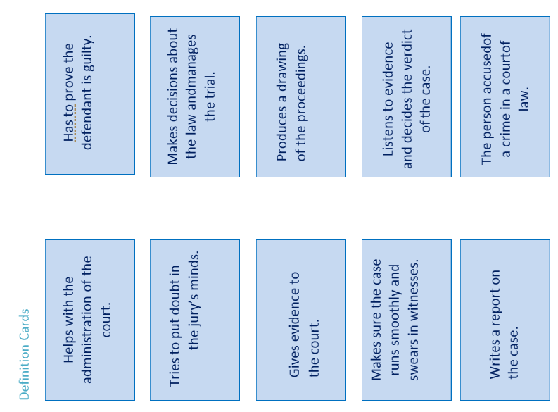
Notes:
Print this slide. Cut the cards and share them randomly amongst the students.

Slide 7
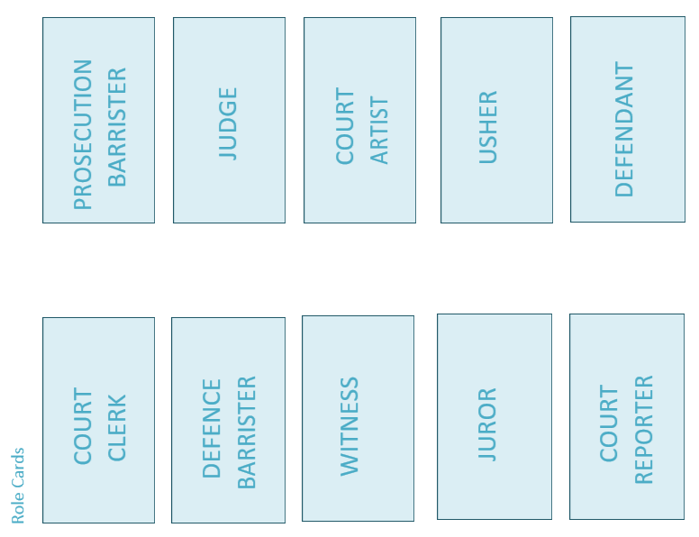
Notes:
Print this slide, cut out the cards, and share them randomly amongst the students.

Slide 8
Answers:
Court clerk: helps with the administration of the court.
Prosecution barrister: Has to prove that the defendant is guilty.
Defence barrister: Tries to put doubt in the jury’s minds of the defendant’s guilt.
Judge: Makes decisions about the law and manages the trial.
Witness: Gives evidence to the court.
Court artist: Produces a drawing of the proceedings.
Usher: Makes sure the case runs smoothly and swears in witnesses.
Jury: Decides the verdict of the case based on the evidence heard.
Court reporter: Writes a report on the case.
Defendant: The person accused of a crime in a court of law.
Notes:
Go through the answers and allow students to do further research on the roles, if necessary.

Slide 9
Preparing for the trial.
You will get your role in the trial.
Prepare for this role (in pairs/small groups)
Read the case to do so.

Slide 10
How to prepare for your role? (15 mins)
Choose a role. The following roles are available:
Defendant, lawyer(s) for defendant, lawyer(s) for prosecutor, witness(es) for prosecution,
witness(es) for defendant, judge, usher, jury members, reporter, sketch artist.
Read the case and prepare:
-Lawyers: prepare opening and closing statements, as well as questions to ask.
Read the witness statements and the case.
-Witnesses: prepare how you might answer possible questions.
Read your witness statements.
-Judge/usher: research how court cases proceed (usher/judge).
-Jury members: complete your jury registration form, read the case.
-Press/sketch artist: prepare how you will report the case (research).
Notes:
Explain to students that they can prepare this briefly. There is no need to be exact in the proceedings. Students don’t need to understand exactly how a trial happens. The main idea is that the look at the case, evidence, and how to ask questions in order to get closer to the truth. The exercise is not a legal one, really. The focus will ultimately go back to TOK.

Slide 11
The case: The State versus Bart
The issue: Did Bart throw the stone that broke Principal Skinner’s window?
Facts
Bart and several of his friends were riding their bikes around the neighborhood on Friday, March 15. At about 6:00 p.m. a few kids from a different neighborhood rode by Bart and his friends. They teased Bart and his friends and dared them to throw stones at Principal Skinner’s windows. Principal skinner is a man of a certain age who often tells the children to stay off his property. Several windows were broken, and when Principal Skinner ran out of his house to stop the children, he recognized Bart. The State has now charged Bart with the crime of vandalism.
Notes:
Show this slide to the whole class and leave it up whilst students prepare for the trial.
Adapted from « Mini-mock trial manual » (freely available for use in classroom setting.)

Slide 12
Notes on the following slides: The next slides will be hidden. Do not show them to the class as a whole. Instead, print the slides or the linked student handouts (see lesson plan/instructions in the notes) and give the handouts to the respective students. Each slide/handout represents one or more pieces of the puzzle, that makes up the court trial. -The students will use the information of these slides to prepare for the trial. -Witnesses need to prepare how to respond to questions asked by the lawyers. -The lawyers need to prepare questions to ask the witnesses and the defendant. They also need to prepare a short opening and closing speech. -The jurors will complete a biography -The press team can help out lawyers and witnesses in preparation for the case.

Slide 13
Jury selection: respond to questions and complete juror form.
Questions for the judge and lawyers to ask the jury:
? Is there anyone who feels he or she cannot be fair in this case?
? Is anyone related to or does anyone know persons involved in this case?
? Does anyone stand to benefit from a decision in this case?
? Has anyone already formed an opinion about the case?
Notes:
Begin the trial (preparation) with the selection of the jury. Explain to students that jurors can be removed from the case if they are biased. The judge and/or the lawyers can ask the above questions to the jury members.

Slide 14
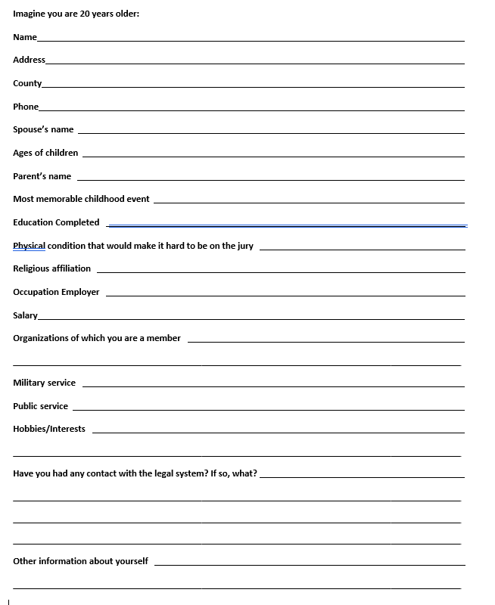
Notes:
Each juror has to complete this form during the preparation time. Students make up a persona. They pretend they are 20 years or older. Print this slide 6 times (one for each jury member).
Taken from citizensinformation.org. Permission to print for classroom use granted.

Slide 15
Prosecutor witness statements
Principal Skinner:
I have lived in this neighborhood for 47 years. My mother and I built our little house when I started teaching. My mother died five years ago. Since then, I have been a victim of many attacks of vandalism. On Friday evening, March 15, I was watching the 6:00 p.m. news when I heard glass breaking in my front porch. I ran out my back door and around the house to see what was going on. I saw lots of kids. I recognized Bart because he lives down the block and often rides his
bike past my house. It was clear to me that this group of kids was responsible for breaking my windows. In fact, Bart had a rock in his hand and was getting ready to throw it.
Notes:
Print this slide 5 times and hand it to the student playing Principal skinner, as well as the lawyers.

Slide 16
Prosecutor witness statements
Leila, the paper carrier:
I have delivered newspapers to Principal Skinner’s neighborhood for three years. On Friday, March 15,
I was delivering a newspaper to Ms. Crowley, who lives three houses away from Principal Skinner, when I heard kids screaming and then I heard breaking glass. I ran over to Principal Skinner’s house. I saw about 10 children on the front yard. Bart and another kid were pushing each other. It looked
to me like the other kid was trying to stop Bart from throwing a stone. I did not see anyone throw stones.
Notes:
Print this slide 5 times and hand it to the student playing “Leila” as well as the lawyers.

Slide 17
Defence witness statements
Milhouse,
Bart and I were out riding our bikes with some other friends on Friday, March 15. We were riding up and down Barts block when a bunch of kids we didn’t know rode up to us and started teasing us. They dared us to throw stones at grouchy old Principal Skinner’s windows. We tried to ignore them. They threw a stone and hit a front porch window. Then they threw some more stones. I think a couple of windows were broken. Bart and I and our friends stood and watched. When one of the other kids picked up a stone to throw, Bart tried to stop him. Then Principal Skinner came around the house. The other kids said they didn’t throw the stones, they said that Bart did. I think they were mad at Bart because he tried to stop them. Bart is a real nice friend, he wouldn’t try to break Principal Skinner’s windows.
Notes:
Print this slide 5 times and hand it to the student playing Milhouse, as well as the lawyers.

Slide 18
Defence witness statements
Bart, defendant
I was riding bikes with my friends on Friday, March 15. It was almost getting dark when a bunch of kids we didn’t know rode up to us and started bugging us. They wanted us to throw rocks with them. They were going to try to break some of Principal Skinner’s front porch windows. Even though I don’t like Principal Skinner very much, we said we wouldn’t do that. I saw one kid standing next to me pick up a rock. I tried to take it out of his hand so he wouldn’t throw it. That’s when Principal Skinner came around the corner. Leslie the newspaper carrier also showed up. I did not throw any stones.
Notes:
Print this slide 5 times and hand it to the student playing Bart, as well as the lawyers.

Slide 19
Going back to TOK: “Our role as a knower”. Plenary discussion of knowledge questions.

Slide 20
Knowledge questions
a. What tools are available to us as knowers to help us evaluate claims?
b. Do knowers have a moral duty to examine their own filters?
c. What personal traits (such as taking seriously the knowledge of others) do we need to be ethical knowers?
d. Is it inevitable that our personal perspectives will play a part in the judgements we make?
e. What shapes my perspective as a knower?

