Slide 1
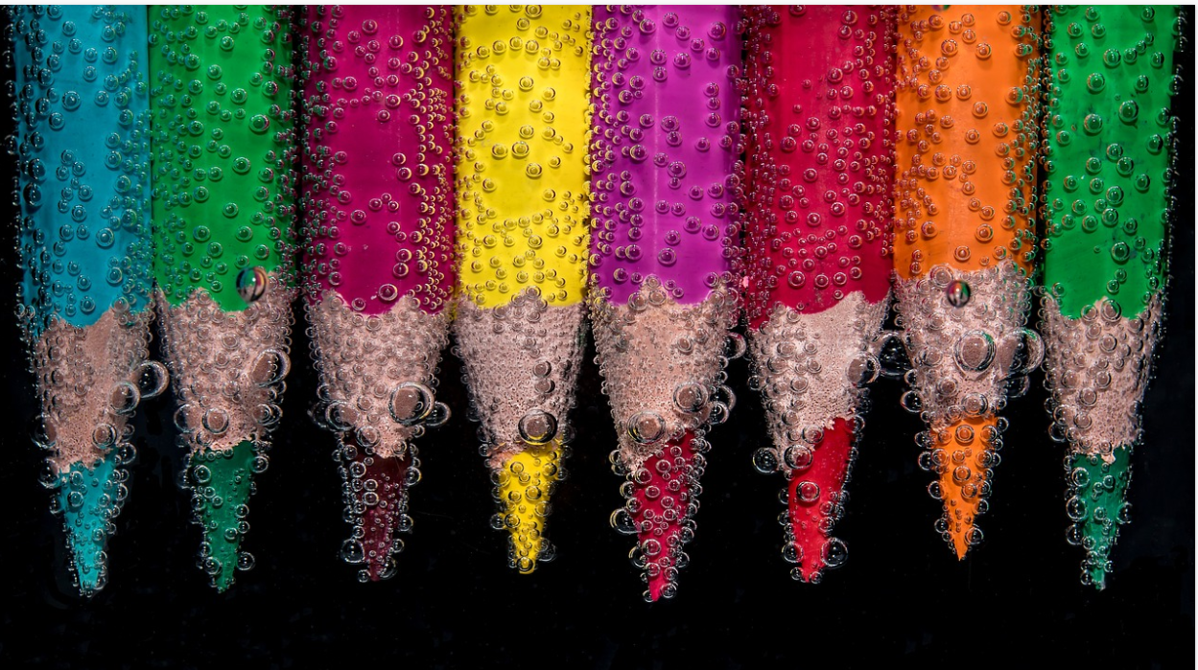
Lesson 3 Interpretation and explanation.
What makes a good explanation and interpretation in the arts?
Is this different for other AOKs?
Notes:
Image from www.pixabay.com

Slide 2
Are you ready?
Get ready to present your work of art to the class (live/video).
You get maximum 2 minutes presentation time per group.
Each work should have a title.
Explain what the work is about.
Explain what medium you used and why.
Focus on meaning and ideas rather than mere aesthetics.
Notes:
Give students a couple of minutes to get their art work/notes ready and to liaise with other members of their team.
Then students present their art work. Encourage the class to take notes throughout the process, so they are ready to cast their votes at the end and explain why they have chosen a particular winner. Obviously, students cannot vote for themselves.

Slide 3
Let’s vote!
Notes:
Ask the students to cast their votes. Remind them that they should be ready to justify why they have chosen a winner.
Optional further reading: https://emptyeasel.com/2006/11/18/how-to-judge-art-five-qualities-you-can-critique/

Slide 4
And the winner is…
Notes:
Ask students to share their votes and reasons for chosing a particular art work/explanation. Count votes and allocate the winner. In case there is a tie- you can do a mini debate/explanation battle and vote again.

Slide 5
Warm-up: Do you remember any of the 12 TOK concepts?
Notes:
Answer: evidence, certainty, truth, interpretation, power, justification, explanation, objectivity, perspective, culture, values, and responsibility

Slide 6
Out of the TOK concepts, which ones are most significant in the Arts?
evidence, certainty, truth, interpretation, power, justification, explanation, objectivity, perspective, culture, values, and responsibility
Notes:
There is no right or wrong answer here. Let students justify their choice. Then explain that we are looking at explanation and interpretation in today’s lesson.

Slide 7
Collaborative brainstorming and research: Interpretation and explanation in “The arts”?
What makes a good or bad interpretation/explanation in the arts?
What criteria could we use to distinguish between both?
ADD EXAMPLES if possible
REMEMBER:
this is about KNOWLEDGE in the arts!
the dynamic between the work of art on its own, the creator and the audience plays an important role here.
Notes:
See linked handout (to be adapted to a Google doc or used as a model to structure the whiteboard).

Slide 8
Mini-essay preparation. What are the justifications for and implications of claiming that there are absolute standards for “good art”?
Notes:
Ask students to write a 500 word response to this knowledge question.

