Slide 1
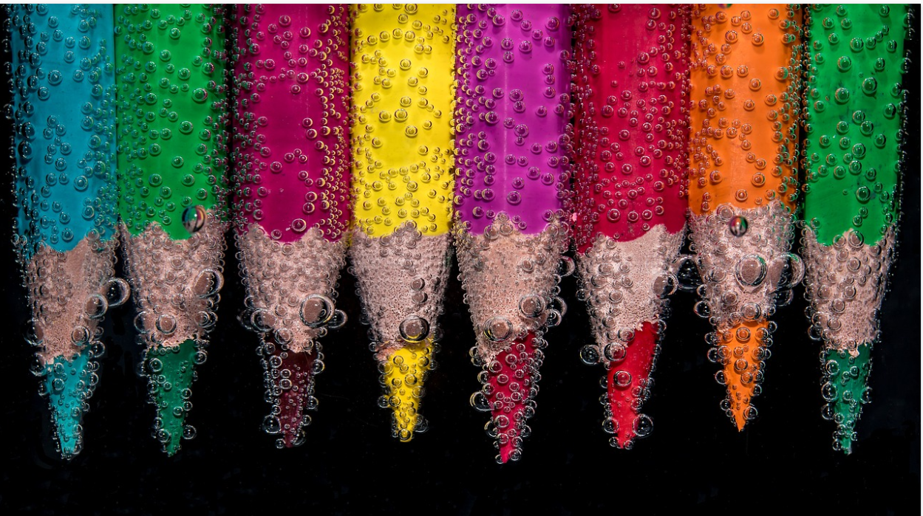
Lesson 2: Convince me it’s art!
A hands-on activity that gets to the crux of what art is all about.
Notes:
Image from www.pixabay.com

Slide 2
Warm-up: What kind of art forms or disciplines within the arts do you remember from last lesson?
Notes:
Warm-up: link to previous lesson: what kinds of art forms/disciplines within art exist? Think-pair-share.

Slide 3
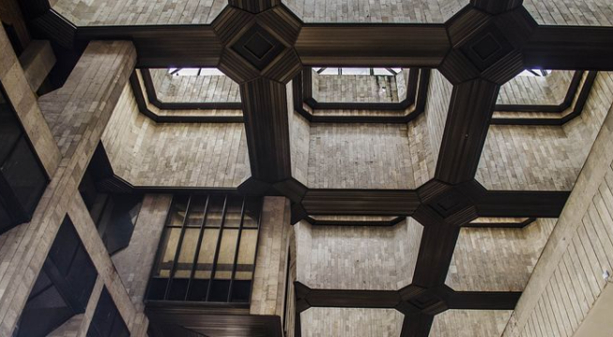
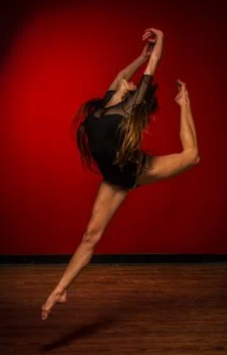
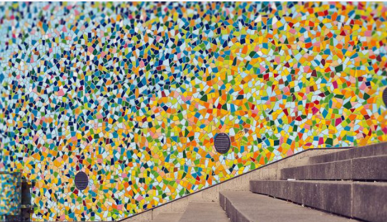
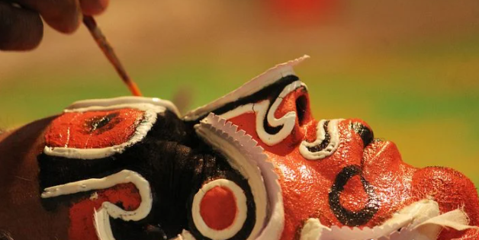
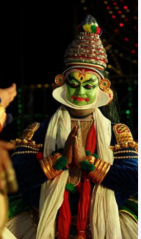
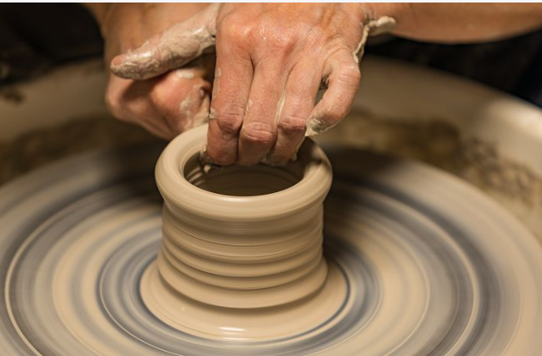
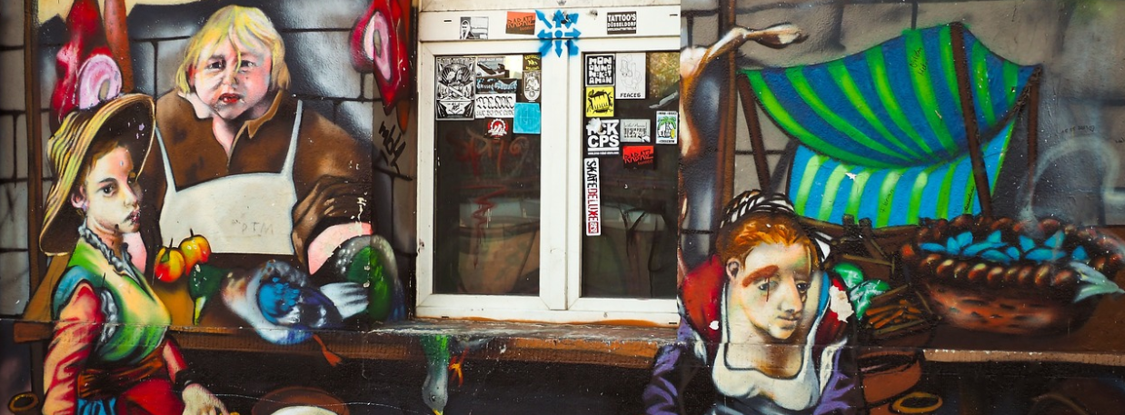
Notes:
Images from www.pixabay.com

Slide 4
Warm-up: What makes art (good) art? (remember our definition of art from last lesson)
Notes:
What makes a good work of art? (review of the elements that help us define art, quick recall, whole class).

Slide 5
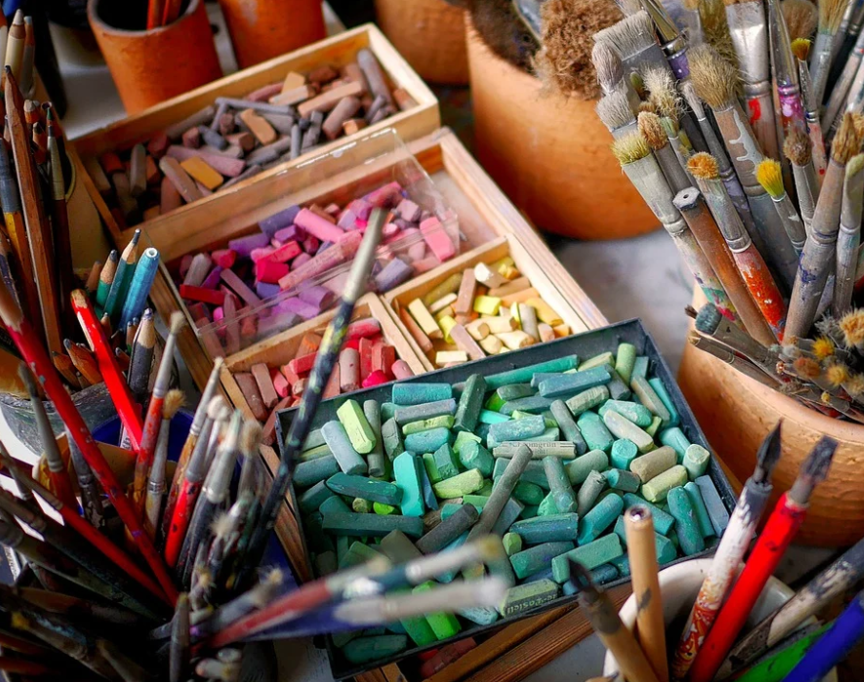
Convince me it’s art!
Notes:
Tell students that you will now move on to the main activity of this unit plan. They will have to create a mock artwork in a limited time frame. Explain that it is meant to be a fun task, and that actual quality of the work of art is not really that important for the purpose of the lesson. Encourage a humouristic, tongue-in-cheek approach.
Students can use anything they find in their immediate environment to create this work of art. (classroom/school/home: depending on the setting in which the lesson is taught).
They can use the rest of the lesson (and after school, if desired) to complete the task. At the start of next lesson, they will present their “mock/fake” art work.

Slide 6
Task: create a mock work of art. Aim: convince the audience that the work is truly worthy of artistic recognition.
Use anything you can find in your immediate environment to create this fake work of art.
Explore a range of artistic disciplines and/or media (eg dance, sound poetry, performance art, installation art, music…).
Give your artwork a title and a deeper meaning.
Be prepared to say what the work of art is about and why you have chosen the medium/style/artistic discipline.
Next lesson: present your work of art to the class. The audience will vote the winner (=most convincing artwork).
Notes:
Encourage students to explore a range of artistic disciplines and/or media (eg dance, sound poetry, performance art, installation art, music…).
Students should give each artwork a title.
Students should be prepared to say what the work of art is about
Explain that the aim of the task is not to create a work of art that will pass the IBDP art exam criteria, but instead, that it aims to convince the class/audience that the work is truly worthy of artistic recognition.
Each student will get 1 to 2 minutes to present their work of art to the class.
The audience will vote the winner (=most convincing artwork).
Tell students that they will present their work of art at the start of the next lesson. Less confident students might create a video recording of their art and/or explanation.
If desired/suitable, this activity can be completed in small groups.

Slide 7
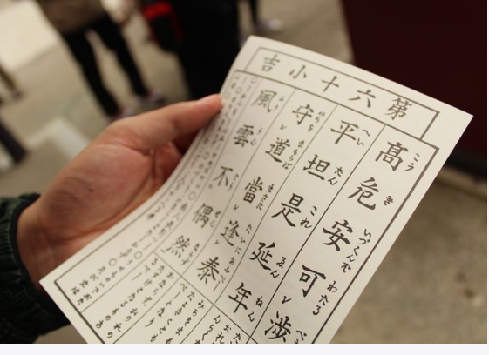
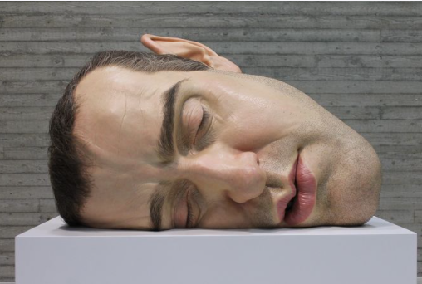
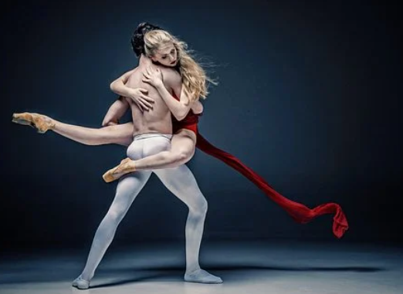
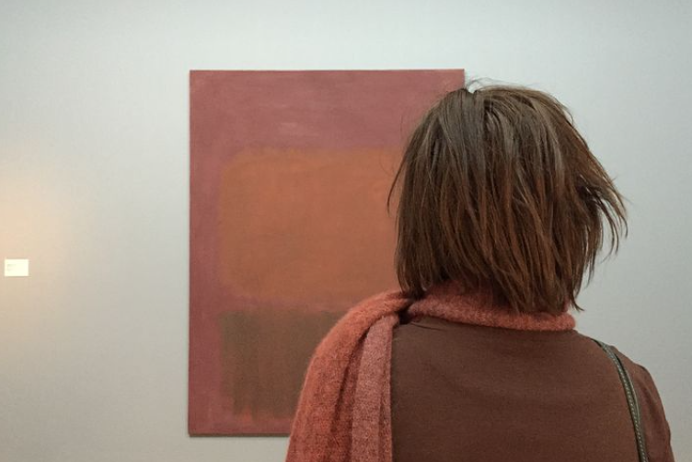
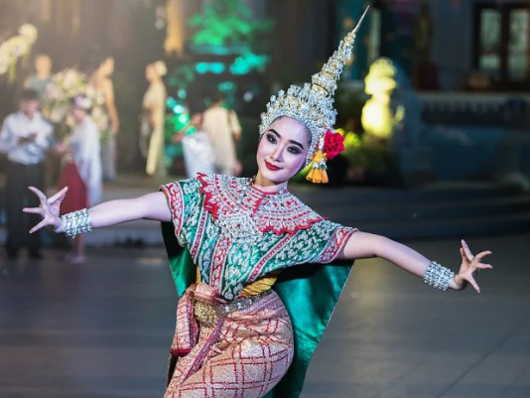
Be inspired…
Notes:
TIP: The following examples created by students of might help guide your students:
A bizarre expressive dance about the pressures of life at IBDP, sound poetry, a photo of undone dishes during lockdown, a still life made of rationed food items, food haikus, abstract paintings, installation art etc

Slide 8
Reminder:
Be ready to present your work of art to the class (live/video).
You get maximum 2 minutes presentation time per group.
Each work should have a title.
Explain what the work is about.
Explain what medium you used and why.
Focus on meaning and ideas rather than creating something merely beautiful.
Work in small groups or independently.
Notes:
Remind students that the exercise is meant to be fun and tongue-in-cheek. Students should try to see what they could get away with in terms of selling something as art. The aim is NOT to spend hours and hours creating beautiful paintings or harmonious songs. The activity aims to uncover TOK elements. It is not an arts competition as such!

