Slide 1
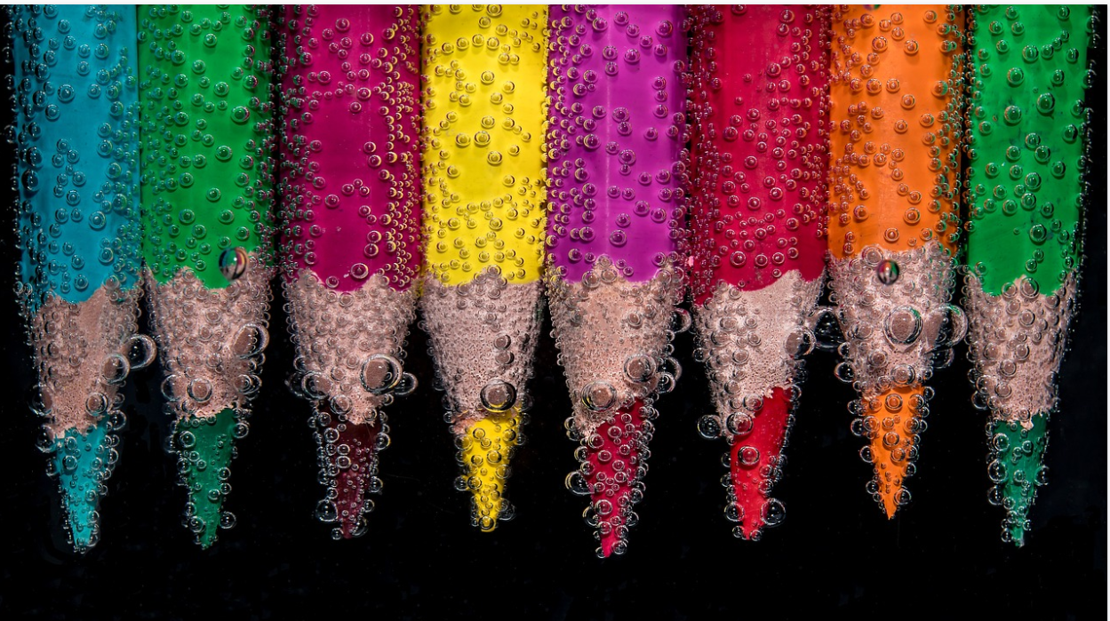
Lesson 1 Just pretty pictures? Think again.
An exploration of knowledge and purpose in the arts.
Notes:
Use in combination with the lesson/unit plan.
Image from www.pixabay.com

Slide 2
Warm-up: How many art forms and disciplines within the arts can you think of?
Notes:
Think-write-share (individually).
TIP: To ensure students consider a wide range of art forms (rather than just visual art), you can make this into a small “competition” (those who can think of the most art forms win). Possible art forms are: music, graffiti, literature, dance, performance art, photography, film, architecture,…

Slide 3
Collaborative brainstorming: What words come to mind if we say “The arts”?
The Arts
Notes:
Divide the class in groups of 4/5 students
Provide each group with large paper to write on, or writable desk spaces.
Write “The Arts” in the middle of the writing space.
Students brainstorm vocabulary and concepts related to the arts
Tell students to look the explorations of other groups and, if desired, add words to their own reflections.
Then ask each group to select the most significant words (highlight/circle/underline).

Slide 4
Now use some of these words to define “art”.
Notes:
Ask each group to use as many of these words within their own definition of what the arts is.
Finally, each team presents their definition on the larger whiteboard. Unpack and explore the definitions as a class.
TIP: When unpacking possible definitions, try to emphasise the importance of the transmission of an idea, or a deeper meaning. This will then lead to the explorations of knowledge in the arts during subsequent lessons.

Slide 5
“Something that is created with imagination and skill and that is beautiful or that expresses important ideas or feelings” (Merriam Webster).

Slide 6
Expression of ideas and feelings.
Notes:
Explain to students that you will now unpack a first aspect of the more standard definition of art, i.e. “the expression of ideas and/or feelings”.

Slide 7
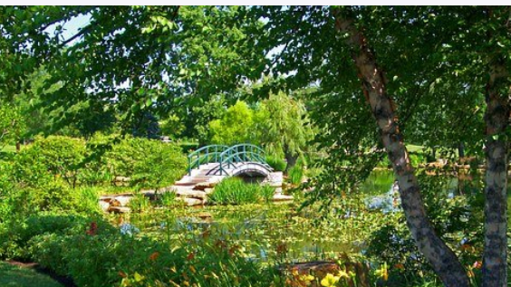
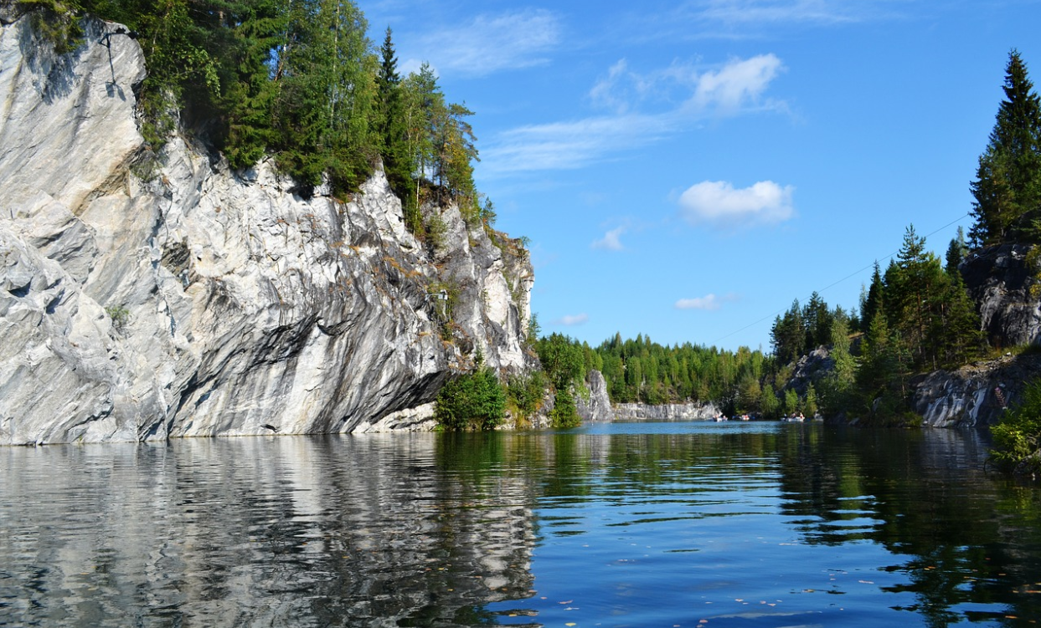
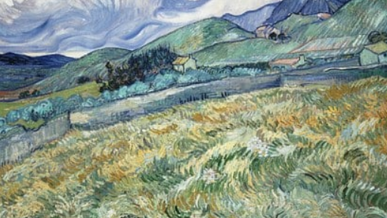
Which is the most expressive? Why?
Notes:
Show students four artistic representations of landscapes: one photograph, one realistic painting, one impressionist, and one from the expressionist movement. Then ask students which one is the most expressive and why. OR use the landscapes on this slide (names of artists/work is not relevant for this exercise, students should offer their ideas on the basis of what they see).

Slide 8
Does the art form/medium affect how knowledge and ideas are conveyed? Are some art forms better suited to express ideas than others? Are others perhaps better at expressing beauty as such? What art form/medium/style would be best suited to express the pressures in your life as an IBDP student?
Notes:
Go back to the initial exploration of the range of art forms (warm up). Ask students whether (and how) the art form may affect how knowledge and ideas are conveyed. Are some art forms better suited to express ideas? Are others better at expressing beauty as such?
TIP: students may juxtapose the beauty of one art form with the expressiveness of another. Use this as a hook to explore the second aspect of the definition of the arts: beauty (point 4).
Ask students which art form/medium/style they would use to express their life as an IBDP student and why.

Slide 9
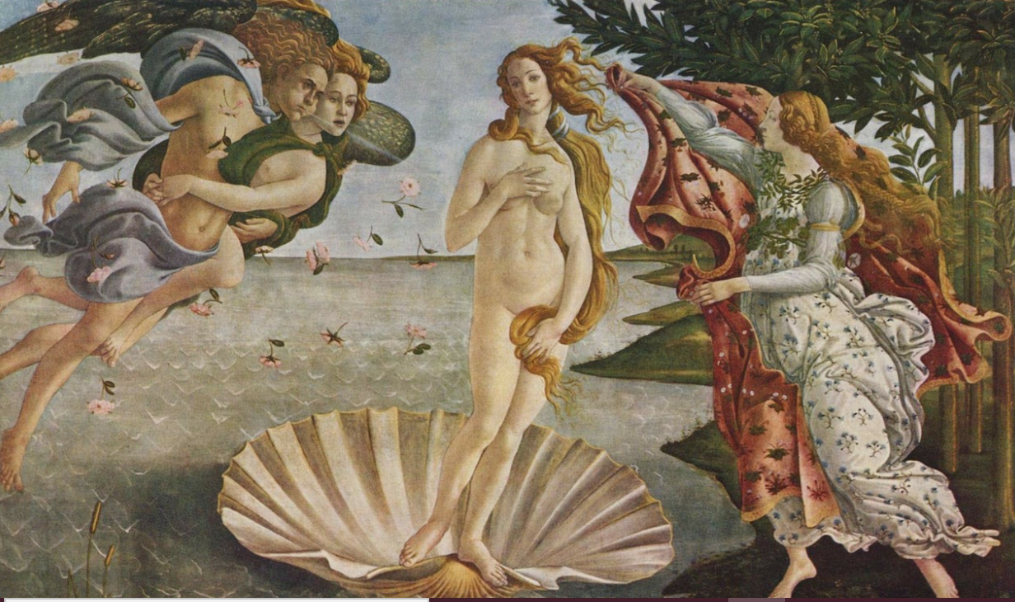
Beauty and truth.
Notes:
Explain to students that you will now unpack the second aspect of the more standard definition of art, i.e. “beauty”.
Venus by Botticelli (Image from Pixabay.com)

Slide 10
(Why) does beauty matter?
Notes:
Ask students why/if beauty matters.
Why might we be so “obsessed” with aesthetics and beauty?

Slide 11
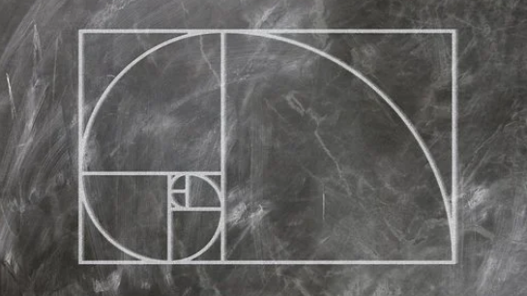
A formula for beauty?
Notes:
Illustration of the golden ratio (considered perfect proportions, used in architecture, paintings etc). Image from pixabay.com
Ask students how we might describe beauty and whether we could come up with a mathematical or scientific “formula” for beauty.
TIP: Check the following link for further research/explanation: https://www.scientificamerican.com/article/is-beauty-truth-and-truth/

Slide 12
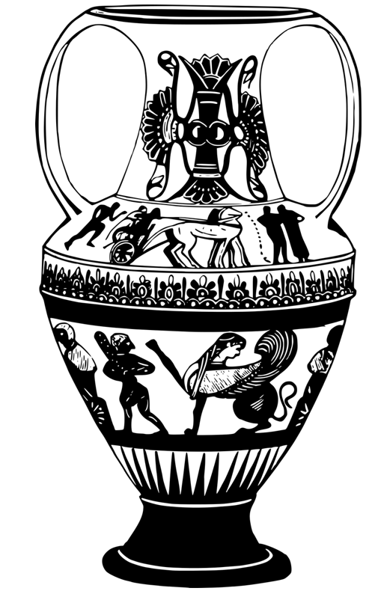
Ode to a Grecian Urn (Keats)
“Beauty is truth, truth beauty,"—that is all Ye know on earth, and all ye need to know.
Notes:
Explain that Keats’s poem “Ode to a Grecian Urn” centres around a poet addressing a beautiful Greek urn (vase). At the end of the poem, the poem images that the poem would say to him: “Beauty is truth, truth beauty, that is all Ye know on earth and all ye need to know”. Ask students what these lines might be about and how/why truth and beauty could be the same things. For more background information about the poem, check this link: https://en.wikipedia.org/wiki/Ode_on_a_Grecian_Urn

Slide 13
https://www.ted.com/talks/murray_gell_mann_beauty_truth_and_physics?language=en
Imagination and skill
Notes:
Optional video on beauty, truth and physics.
“Armed with a sense of humor and laypeople's terms, Nobel winner Murray Gell-Mann drops some knowledge on TEDsters about particle physics, asking questions like, ‘Are elegant equations more likely to be right than inelegant ones?” (TED.com)
Explain to students that you will now unpack a third aspect of the more standard definition of art, i.e. “imagination and skill”.

Slide 14
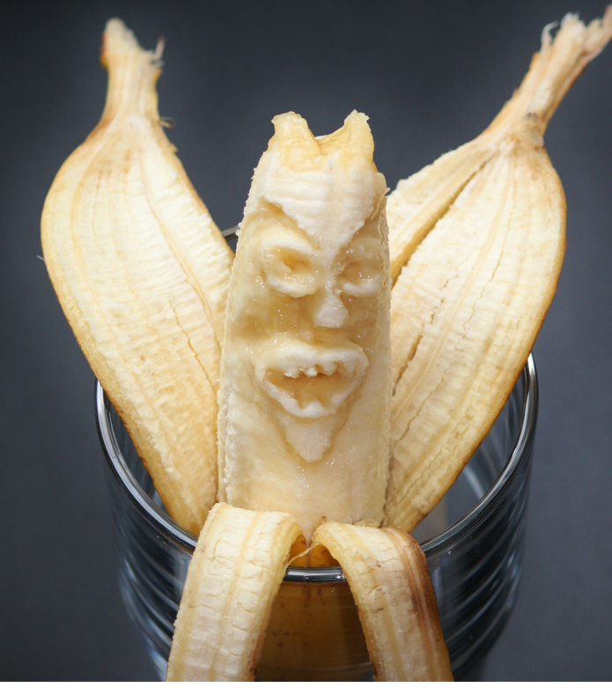
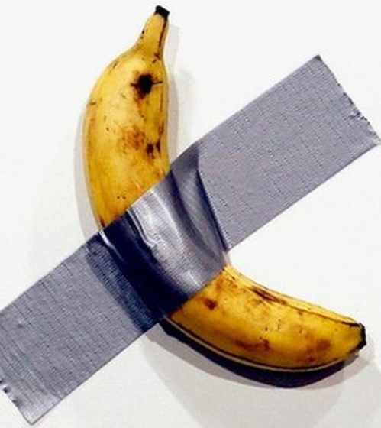
Which one requires most skill?
Notes:
https://www.huffpost.com/entry/banana-duct-tape-art-basel_n_5deaab59e4b0913e6f8fd0b8
Images from pixabay.com (left) and bbc.co.uk (right)
Start with the banana examples: a banana with a face carved in (a), a banana stuck on the wall with duct tape (b) (slides 15-16).
Which one require more skill? Which one more imagination? Then explain how an artist sold the duct tape banana for 120 000 dollar.
https://www.huffpost.com/entry/banana-duct-tape-art-basel_n_5deaab59e4b0913e6f8fd0b8

Slide 15
Is skill enough to make something art?

Slide 16
How can the arts, through imagination, can give use knowledge that reality hides?

Slide 17
Plenary: what is art for?
https://www.youtube.com/watch?v=sn0bDD4gXrE
Notes:
Show students this video: https://www.youtube.com/watch?v=sn0bDD4gXrE
Then ask them to reflect upon more pointers as to what art is for (think/write/pair/share Or use apps such as Jamboard).

