Slide 1
Religion and the natural sciences
Real-life situation: Pastafarianism.

Slide 2
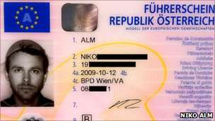
Real-life situation: the case of Pastafarian passport photos on ID’s.
Austrian citizen has won the right to be shown on his driving-licence photo wearing a pasta strainer as "religious headgear".

Slide 3
Pastafarianism and the church of the flying spaghetti monster
Notes:
Q: How do Pastafarians believe our world was created?
A: We believe the Flying Spaghetti Monster created the world much as it exists today, but for reasons unknown made it appear that the universe is billions of years old (instead of thousands) and that life evolved into its current state (rather than created in its current form). Every time a researcher carries out an experiment that appears to confirm one of these “scientific theories” supporting an old earth and evolution we can be sure that the FSM is there, modifying the data with his Noodly Appendage. We don’t know why He does this but we believe He does, that is our Faith.

Slide 4
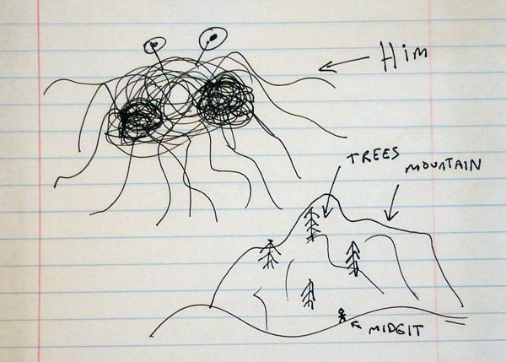
Bobby Henderson’s open letter (2005) to Kansas school board:
Click on the link to read the letter.
http://www.venganza.org/about/open-letter/

Slide 5
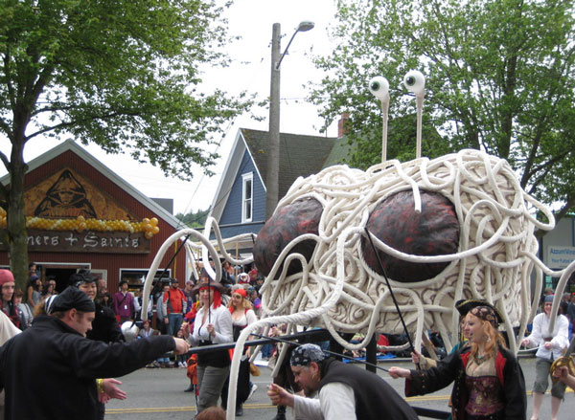
Pastafarian wedding in New Zealand.
Pirate costumes and rings out of pasta.
Q&A
Pastafarianism around the world

Slide 6
What makes a belief a belief?
What makes a religion a religion?
What counts as evidence in religion?
What counts as evidence in the natural sciences?
Can we reconcile religion and natural sciences?
Is there knowledge religion can give us which other areas of knowledge can’t?
http://www.theguardian.com/commentisfree/2016/apr/19/pastafarian-nebraska-ruling-religion-belief-ritual
Notes:
Q: To what extent do Pastafarians need evidence to support their beliefs? What is considered valid evidence, and why are some religious ideas lacking evidence believed more widely than others? Why is Christianity more widely accepted than Pastafarianism?
A: For many religions, acceptance is due to the time it has been around and due to the number of people who already follow it. For potential followers it’s often less a consideration of evidence, and more a judgment that the collective group of followers is better informed. That millions or billions of people already follow this religion is strong social proof that there is something to it. The larger the group and the longer it has been around, the more pronounced the effect.
But nonbelievers are overreaching when they dismiss the phenomenon of religion as wrong and useless because it so often lacks a basis in evidence. The fact that millions of people get something positive out of a religion – even if it is based in superstition – *does* mean something. But that’s not to say it’s True, only that it has Value. For many people, religion is about being part of a community and being part of something bigger and more important than themselves. These transcendent experiences are something we want to emulate.
Nonbelievers would be better off criticizing only on the negative, damaging parts of religion, and being less judgmental about the idea of religion in general. Nonbelievers get hung up asking for evidence when really we should be looking at why does religion thrive despite evidence? We should be pushing the idea that faith is not equivalent to evidence-based-reasoning without insisting that it’s inferior, only that they are different ways of seeing the world. And that the problems happen when these world views clash.
Pastafarianism is different than most religions in that we explicitly make the point that our scripture need not be believed literally. In other religions this is known but not often said out loud (many Christians don’t take the Bible literally but won’t volunteer this). Pastafarian scripture has some outlandish and sometimes contradictory components – and unlike the scripture of mainstream religion, these pieces were intentional and obvious, and our congregation is aware of this.

