Slide 1
What is History?

Slide 2
Definition:
Continuous record of (esp public) events.
Study of past events
Past or record

Slide 3
Some Issues for History Students:
How do we know what happened in the past?
Can we ever have an accurate picture of what happened in the past?
What factors can prevent us from getting an accurate picture of the past?
Who decides what history we study?

Slide 4
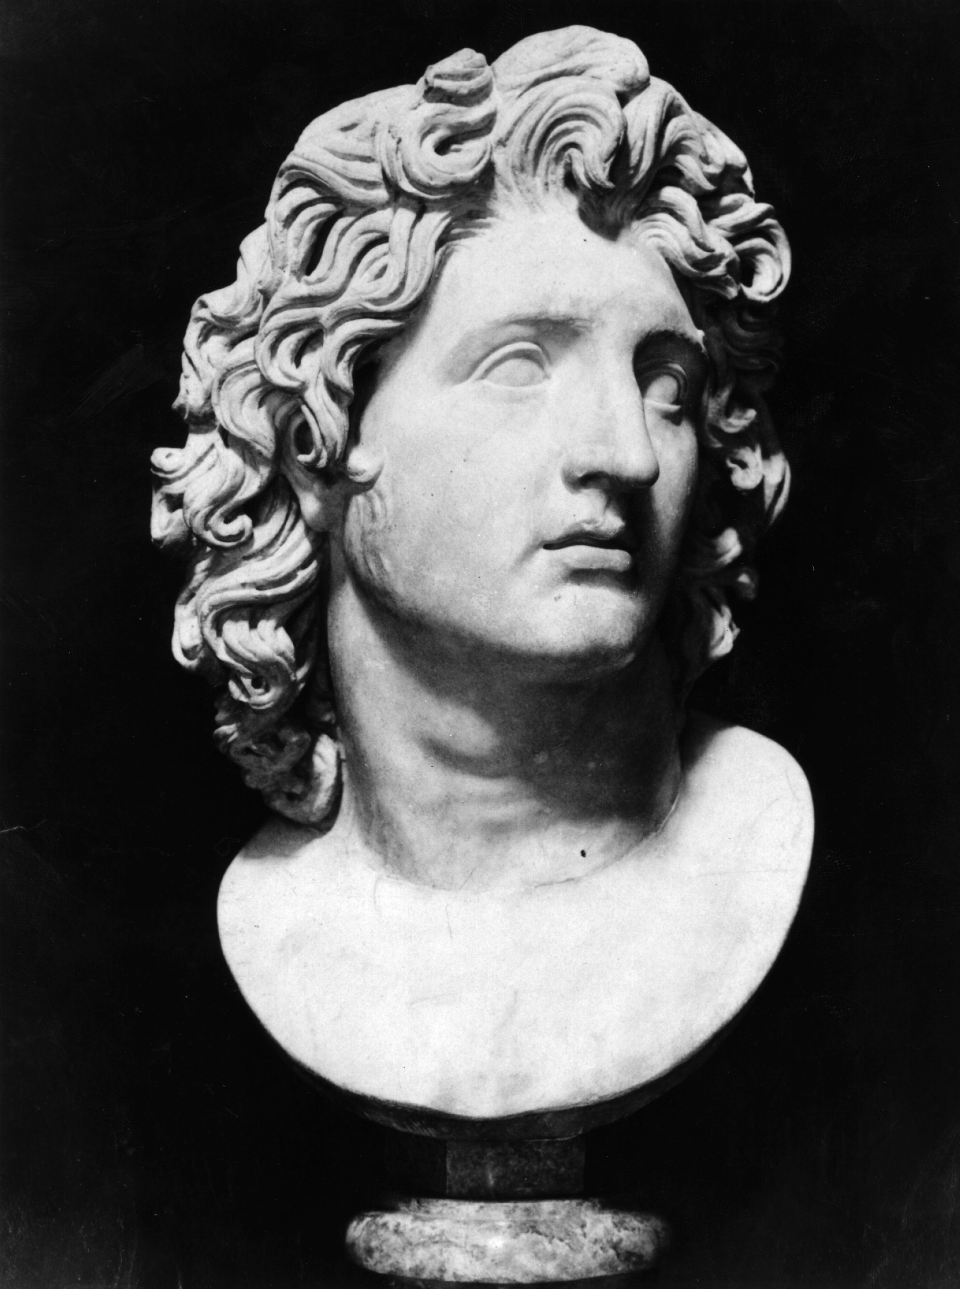
Limited Range of Sources

Slide 5
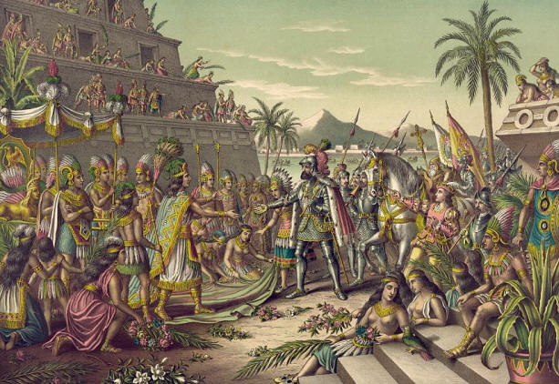
Limited Range of Sources

Slide 6
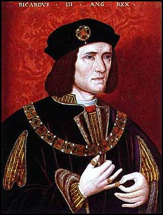
Rewriting History

Slide 7
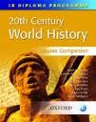
Accessing the Past: textbooks.

Slide 8
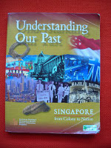
Airbrushing the Past and Indoctrination.

Slide 9
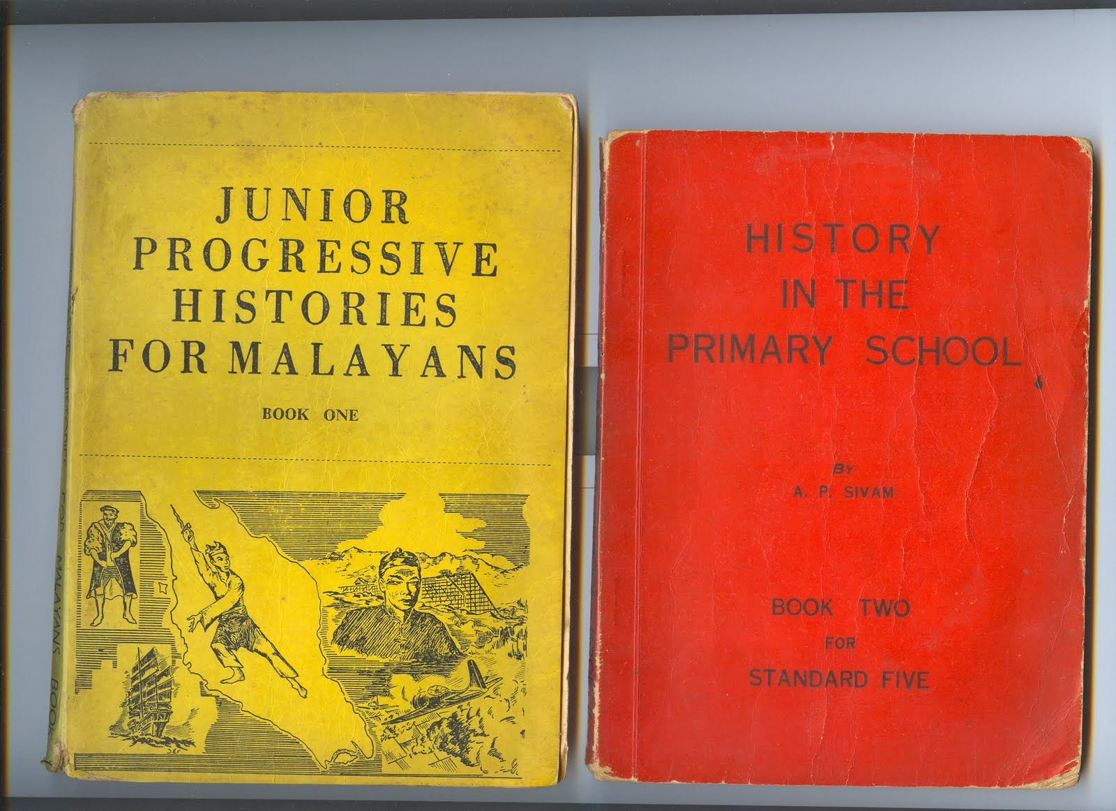
Westernisation?

Slide 10
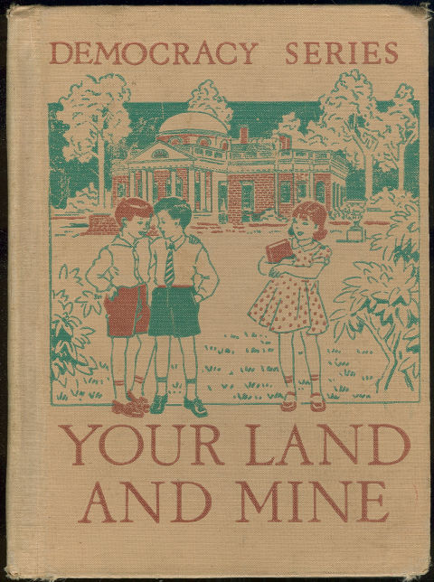
Indoctrination?

Slide 11
Although Saladin was a Turk he was an honourable soldier.

Slide 12


Slide 13
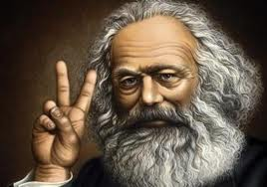
Schools of Sejara: Marxist Determinism

Slide 14
Nineteenth Century Mill Owner
I feel in my conscience that I should do something for my workers. Does the bible not say that I must help my neighbour? I would be shrinking in my God-given responsibility if I did not educate my workers, to curb their gin-drinking and their vicious lives. I will build them decent housing, close the public houses and give them rational forms of entertainment.

Slide 15
Marxist Response.
How convenient! You say your ideas are shaped by the promptings of God within your soul and the study of the bible. They are actually shaped by your economic need. What you want is a skilled workforce, so you educate them. You want them to be disciplined and punctual so you build houses near the factory and stop their traditional visits to inns. You may not realise it but your religion is a cloak for your class interest. In church your workers will no doubt hear the preacher encourage them to be deferential, hard-working and to accept their position in life.

Slide 16
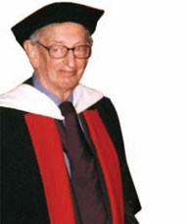
Left

Slide 17
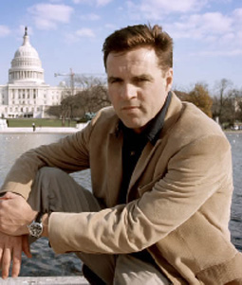
Right

Slide 18
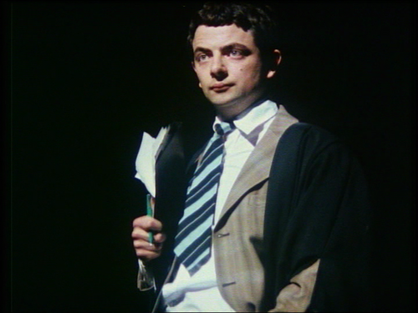
Don’t believe teachers.

Slide 19
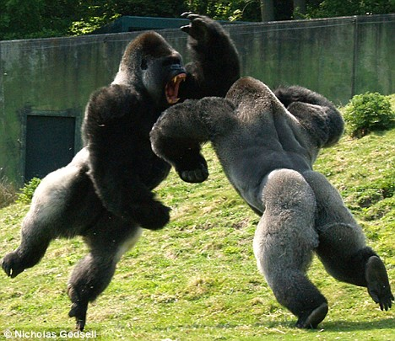

Slide 20
